Slide 1

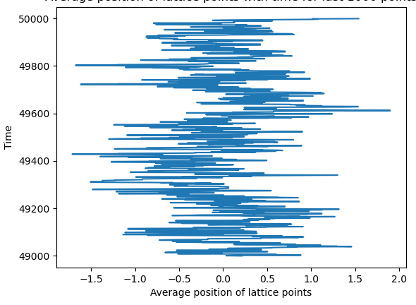
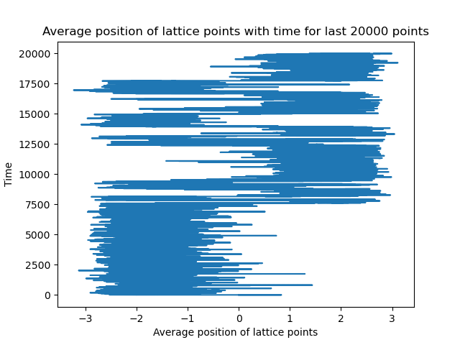
Quantum Harmonic Oscillator on a Computer
Supervisors: Dr. Anthony Kennedy, Dr. Roger Horsley
Introduction
This project simulates a Quantum Harmonic and a Quantum An-harmonic oscillator, and looks at how these two systems evolve using the Metropolis version of the Markov Chain Monte Carlo Method.
As one of the few Quantum Mechanical systems with an analytical solution, the Quantum Harmonic Oscillator is the ideal system to simulate as it can help model problems and make predictions in many areas of Modern Physics: The study of Phonons and in the study of Molecular Vibrations, among others.
Sahaj Porwal
Results
The main results were the representative paths for both the cases(harmonic and an-harmonic), which arose from their potentials and the metropolis algorithm.
Conclusions
Implemented the Quantum Harmonic Oscillator and reproduced its expected behaviours. Also made a reasonable model for the an-harmonic oscillator which shows the expected trajectories(with tunnelling between the two minima positions).
Future work could include: higher dimensional harmonic oscillator to model spherical potentials, interactions between multiple chains of harmonic oscillators, and other systems.
Figure 1: Distribution of comment codes.
Method
The Metropolis Method uses randomly generated increments to the displacement from the equilibrium position of a line(1D lattice) of particles based on the principle of minimising the potential energy.
Figure 1: Oscillations of a Quantum Harmonic Oscillator, oscillating about the equilibrium position x = 0.0
Figure 2: Oscillations of a Quantum An-Harmonic Oscillator, oscillating about the two minima positions x = +2, and -2. Also showcases tunnelling(instantaneous transfer between the two minima).
Acknowledgements
Thanks to Dr. Kennedy and Dr. Horsley for their guidance and support through the project.
Notes:
Copyright Colin Purrington (http://colinpurrington.com/tips/academic/posterdesign).

